Slide 1
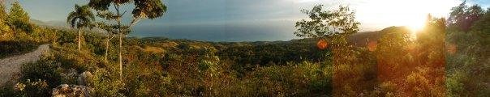
ENGINEERS WITHOUT BORDERS UCF
Project Team

Slide 2
https://www.youtube.com/watch?v=HGiHU-agsGY

Slide 3
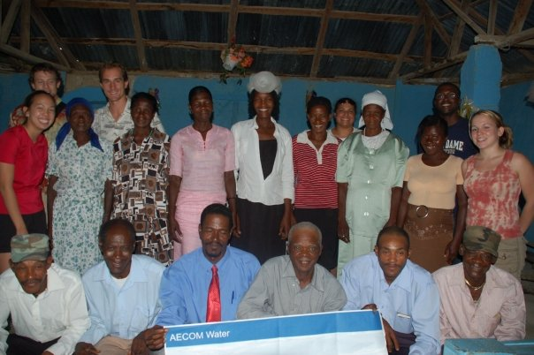
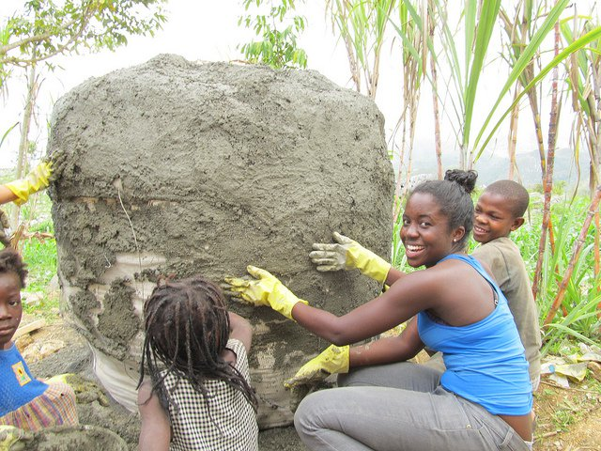
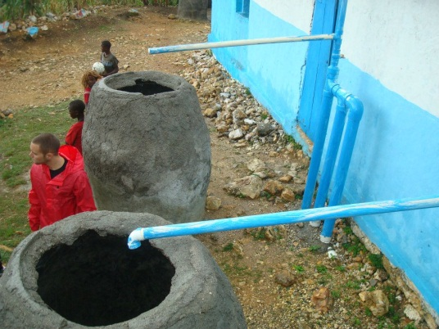
Project Process
Assessment
Implementation
Monitoring

Slide 4
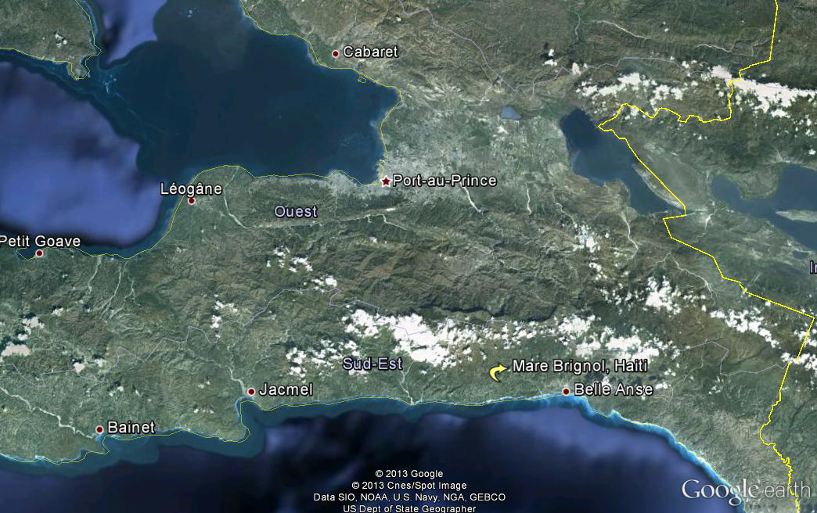
Project Location
Mare Brignol, Haiti
GPS: Lat. -72.1547, Long. 18.2692

Slide 5
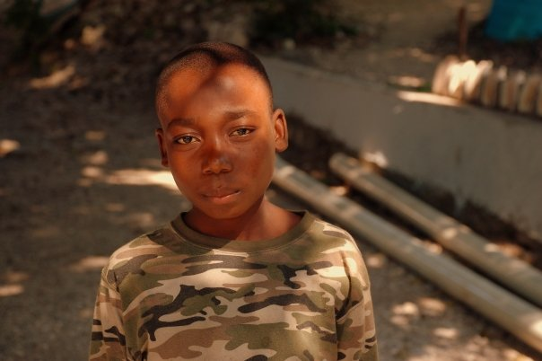
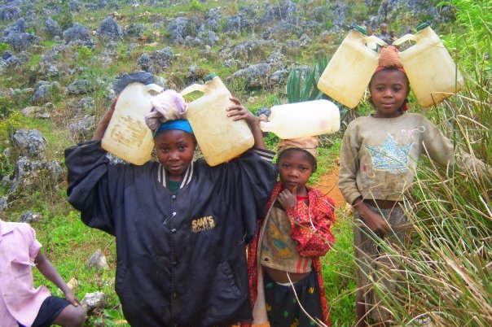
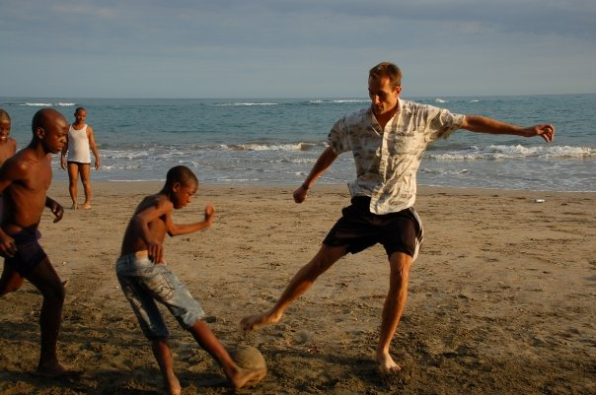
Community
~ 300 residents
Mostly subsistence farmers
Nearest spring is 6km

Slide 6
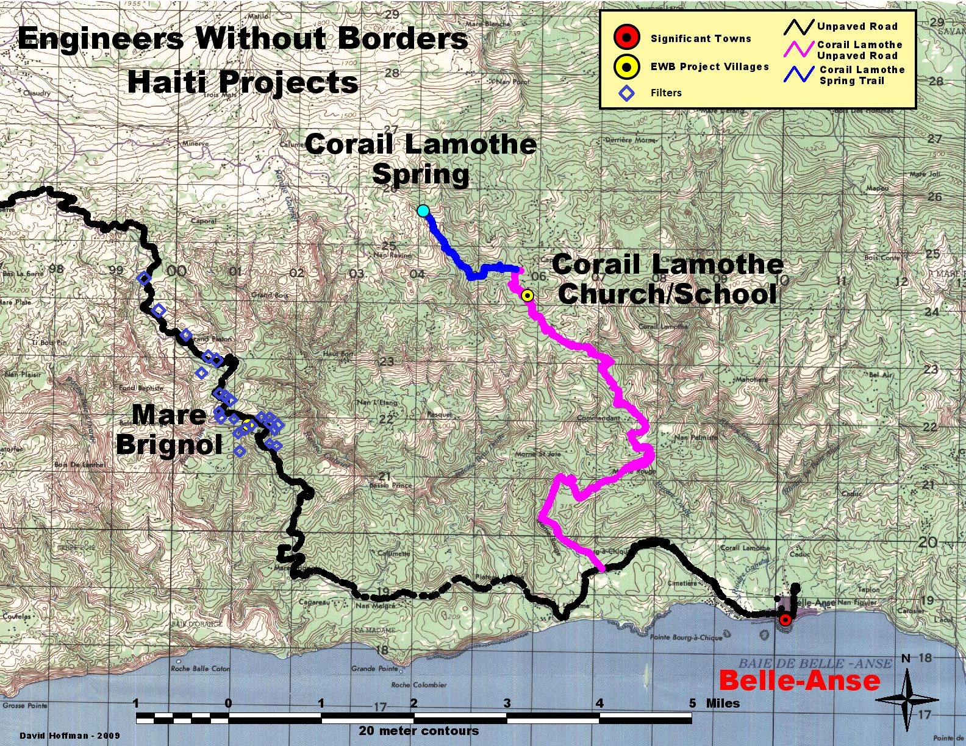

Slide 7
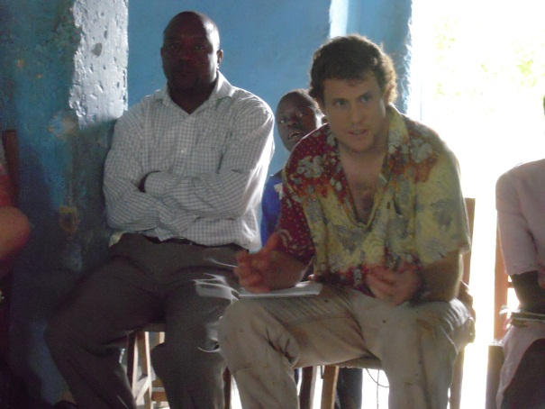
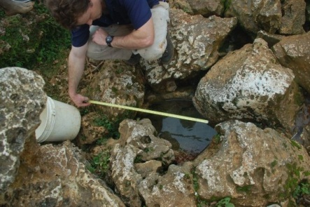
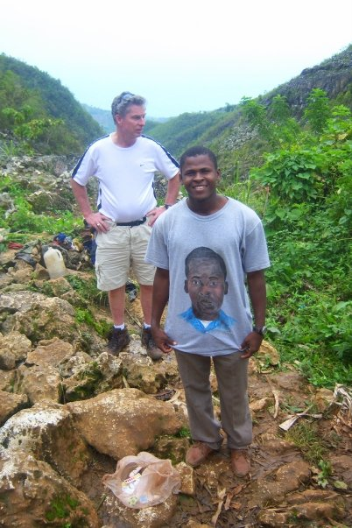
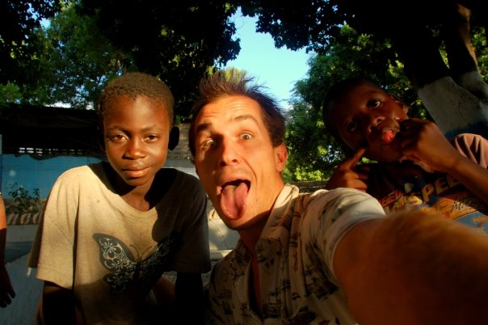
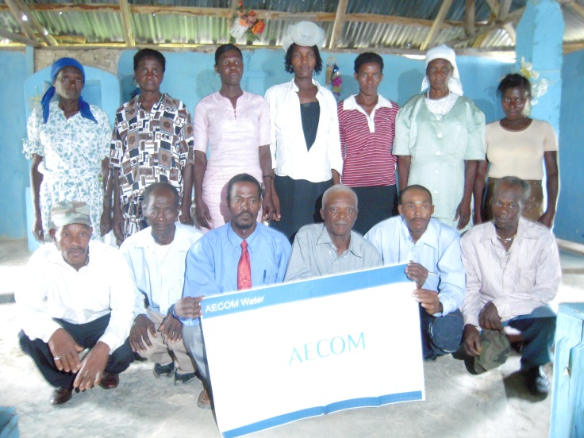
Assessment
Dec. 2008
Mar. 2009
May 2009
Water Source
Bruce Goddard & Bekert Descollines
Mare Brignol Water Committee

Slide 8
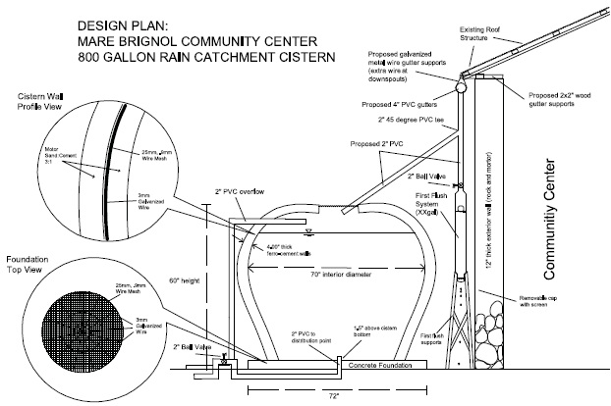
Design

Slide 9
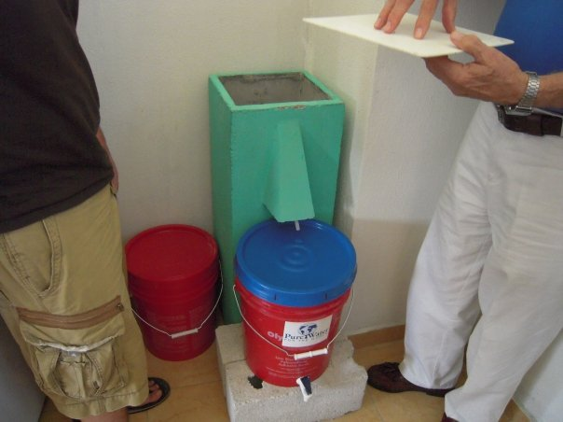
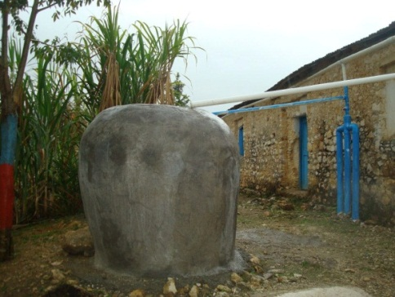
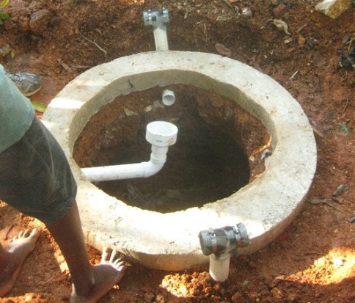
Implementation
Dec. 2009 – Jan. 2010
Composting Latrines
Pilot project: bio-sand filters
May 2011
Additional bio-sand filters
Rain Catchment System

Slide 10
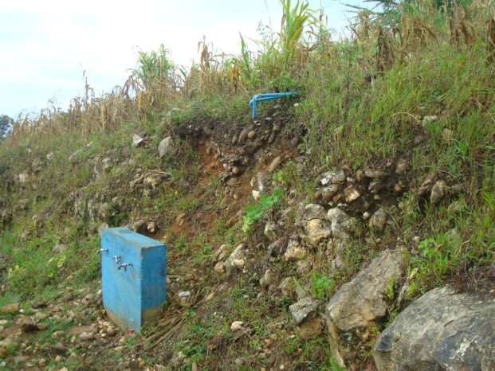
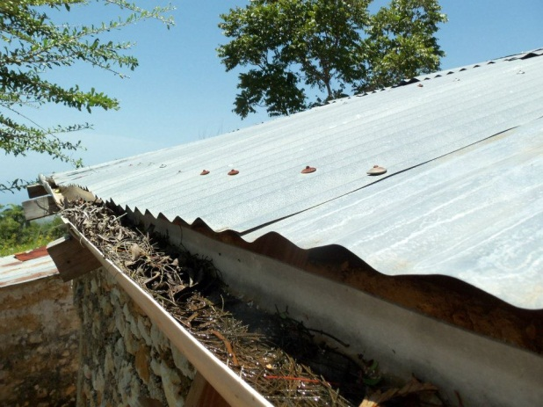
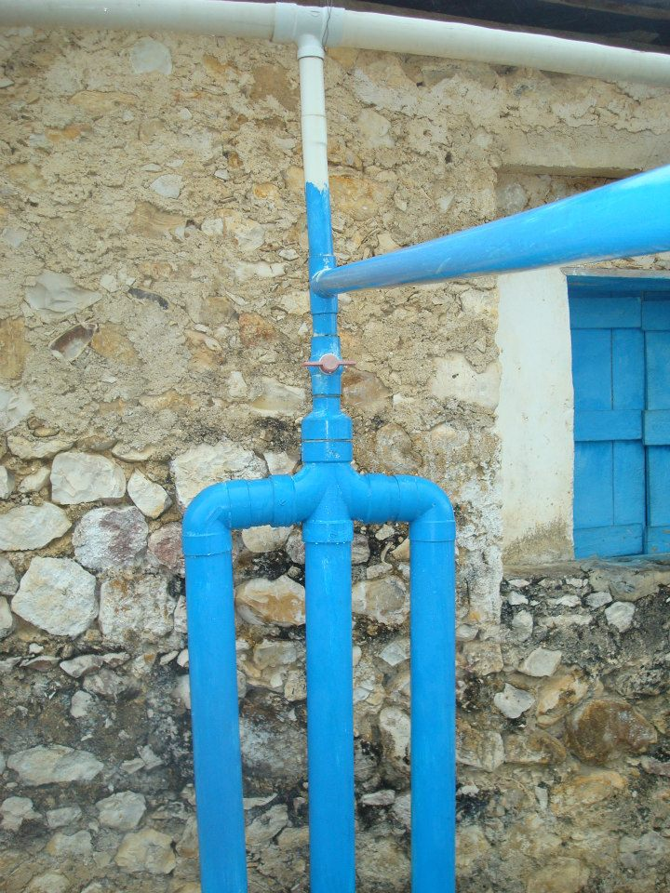

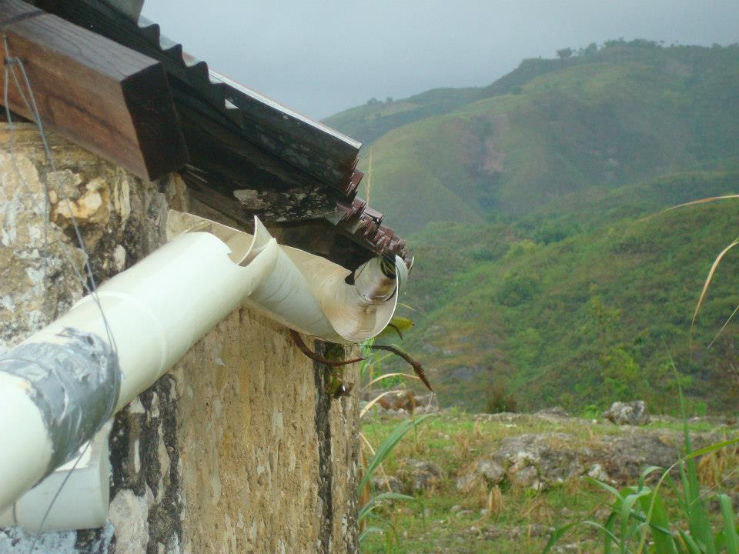
Monitoring
Broken tap station
Unmaintained gutters
First flush system
Cisterns with missing lids
Bent gutters

Slide 11
This slide intentionally left blank

Slide 12
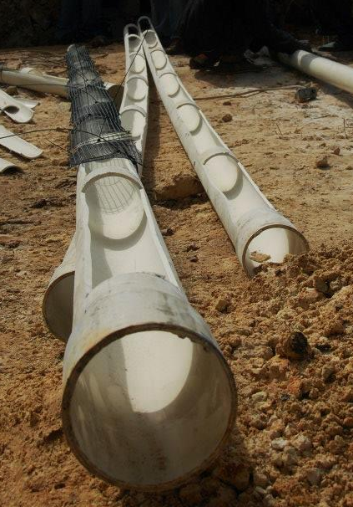
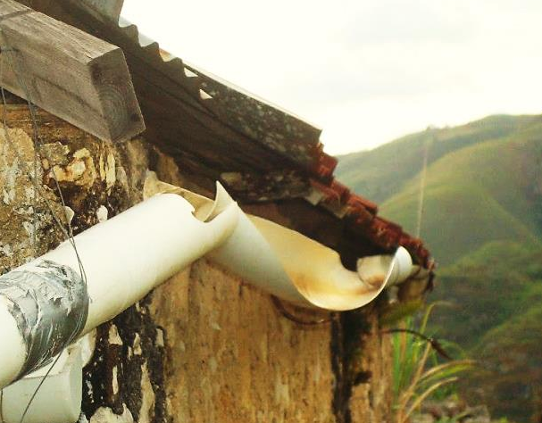
Lessons Learned

Slide 13
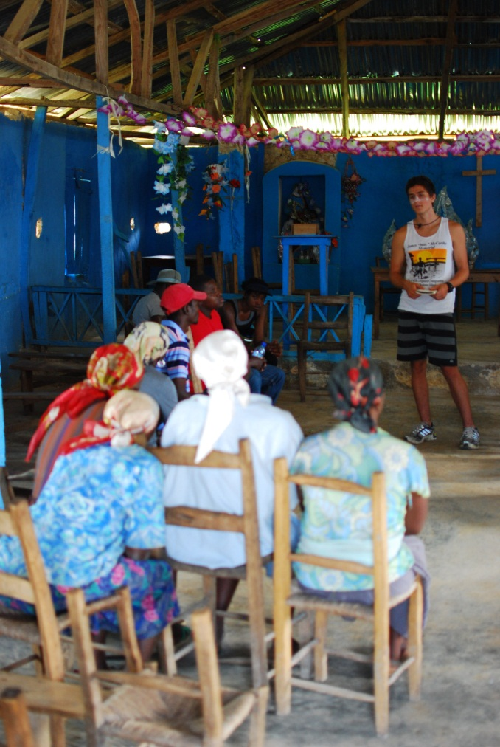
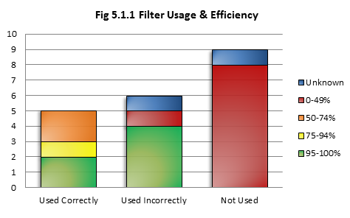
Assessment
23 of 34 filters located
Most filters not used

Slide 14
Moving Forward
Space Coast Florida Professionals
New Program
Uganda
Kenya
Mini Project – Weather Station

Slide 15
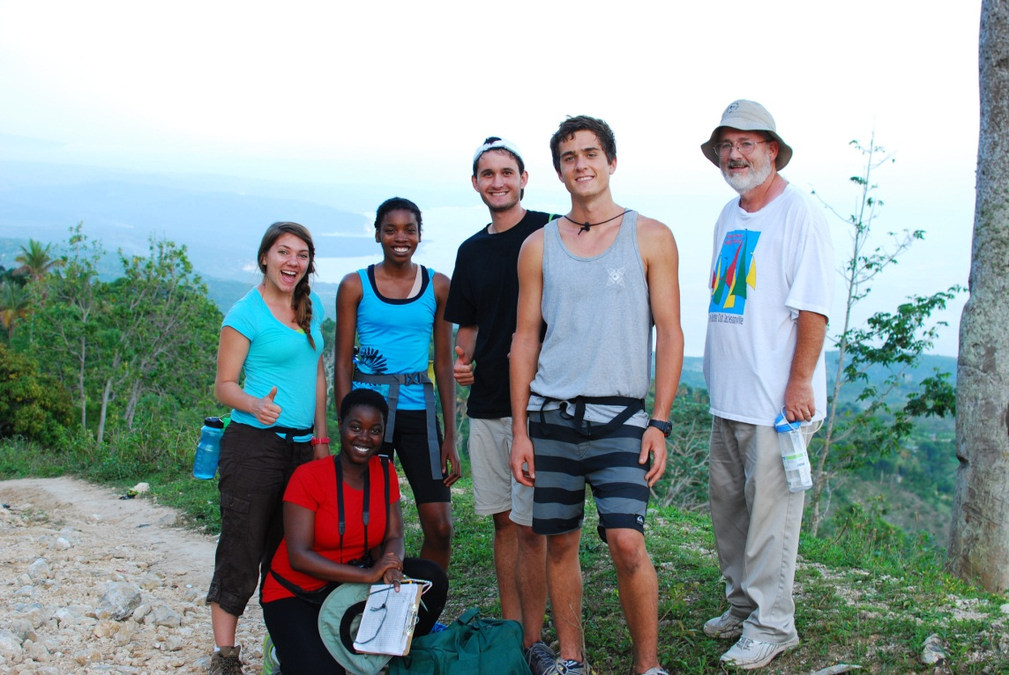
Questions?
Building a better world one community at a time
www.ewbucf.org

